Slide 1
ALISON: Advanced Learning Interactive Systems Online
Nick Jeans and Bieke Schreurs
POERUP team
OER 14, 28 April 2014, Newcastle

Slide 2
case study for EU-funded programme, ‘POERUP’ – Policies for OER Uptake (http://www.poerup.info/)
Partners in several EU countries researching initiatives across all sectors in all countries
Aim to understand how governments can stimulate uptake of OER

Slide 3
‘Advance Learning Interactive Systems Online’
Resources not open in sense of being copyright-free and easy to re-purpose
But as defined by UNESCO (2002): “digitized materials offered freely…for educators, students and self-learners to use for teaching, learning and research”

Slide 4
significant international player in provision of free online courses for Further and Adult Education (where OER less available than in HE)
3m students on 600 free online courses
350,000 completers
200,000 more each month
founder Mike Feerick: expansion will accelerate
1 billion students by 2020

Slide 5
Uses social media for marketing 10,000 have shared their stories

Slide 6
Global reach, mainly Anglophone countries - North America, India, Australasia, Middle East + Sub-Saharan Africa

Slide 7
Awards at World Innovation Summit for Education Best Practice (Qatar 2013) + UNESCO Award for Innovation in ICT for Education
FE equivalent to much-heralded Khan Academy in US (secondary schools)

Slide 8
Focus on employability skills: vocational, ESOL, Languages, Maths, Sciences

Slide 9
For-profit Social Enterprise: uses advertising to pay for provision
Google’s pay-per-click system: Google pays ALISON whenever learner clicks on advert
additional premium services:
ALISON Manager to manage learner groups (max 50 students)
charge for paper certificates/parchments

Slide 10
Slow start 2007 in Galway, Ireland. Staff of 3
Breakthrough year 2010: British Council, Microsoft + Irish Health and Safety Authority
ALISON helped Health and Safety Authority develop online materials.
No longer develops materials
Staff now 30+

Slide 11
simple way to broadcast ready-made materials, using Moodle platform
Other publishers earn split on revenue generated through display of content
As more learners click on ads, fewer adverts needed, less intrusive

Slide 12
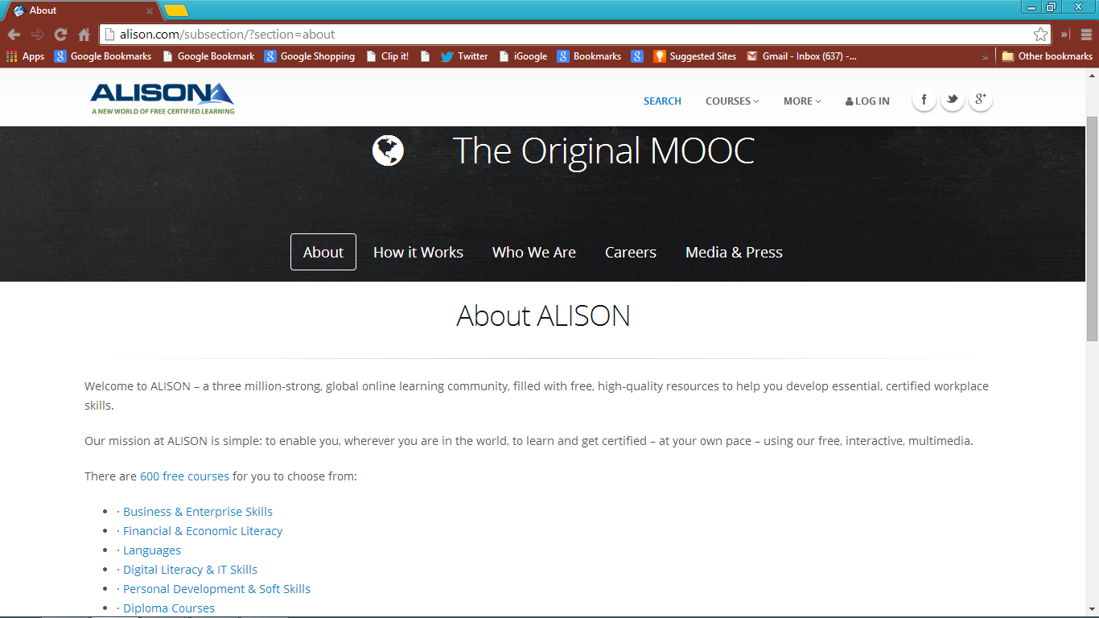

Slide 13
Needed expert Moodle technician (Amr Hourani) + drive / self-belief of manager (Mike Feerick): kept staff costs to minimum when times were hard
ALISON may squeeze out other providers?
Become default provider of vocational education, like Amazon for shopping?

Slide 15
model can be replicated
Some aspects could be improved
Could use learner feedback to improve materials + correct errors
Just passive platform for content
Allow / facilitate repurposing?

Slide 16
‘Correct' answer for question 2: 'a socks‘, not 'a sock'

Slide 17
(Ex FE / Adult Ed teacher)
Use for self-directed learning between lessons, maintains learner progress
Lesson less for teaching, more for encouragement + guidance to appropriate materials (Sugata Mitra)

Slide 18
Further information
POERUP website: http://poerup.info
POERUP wiki: http://poerup.referata.com/wiki/
Contact information
Nick.Jeans@sero.co.uk

